Slide 1
Intro to electronics
Dexter R. Shepherd

Slide 2
Contents
Uses of microcontrollers
Existing microcontrollers
Sensors and outputs
Python

Slide 3
Quick recap of data types

Slide 4
Representing data (the basics)
When you learn to code we have these main data types:
Boolean, integer, float, string
In ML we typically work with numeric values.
Even language based modules use numeric representations of words such as word vectorization

Slide 5
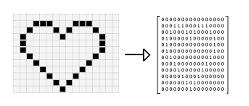
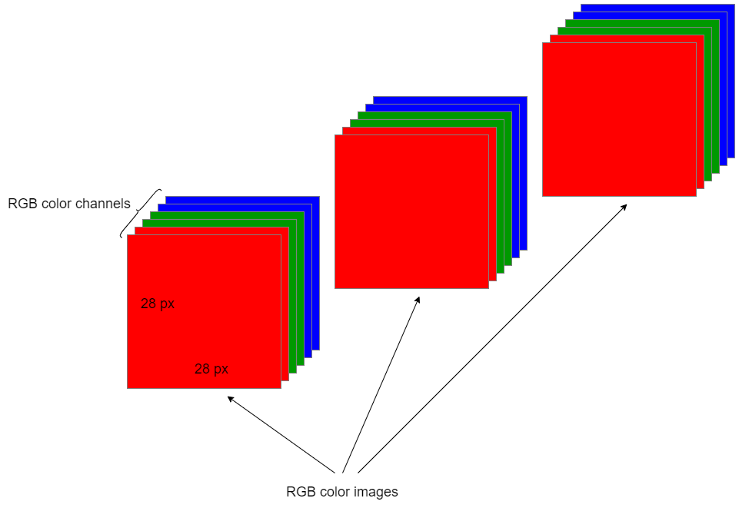
Images (the basics)
Images are matrices
Pixels are represented by tuples (R,G,B) where a numeric values are an integer between 0 and 255 representing how much colour of each R G B.
A grayscale image is simply one value of 0-255
Colour image: H x W x 3
Grey scale: H x W x 1

Slide 6
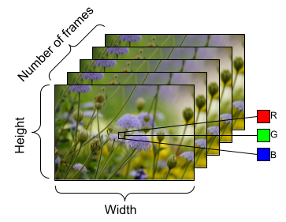
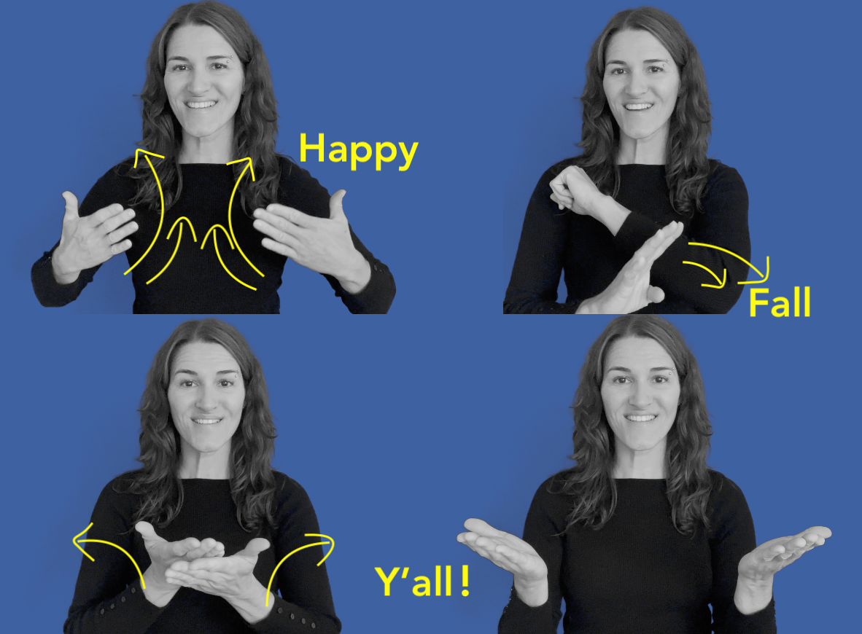
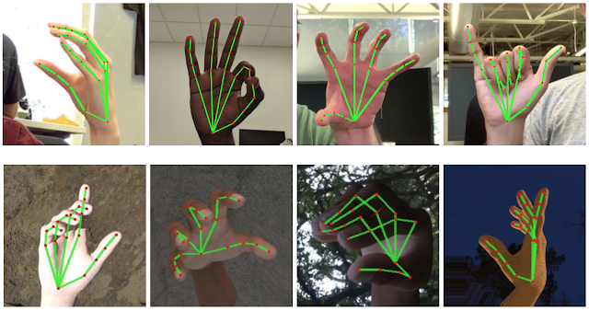
Videos
Arrays of images
Can be treated as time-series data depending on the task

Slide 7
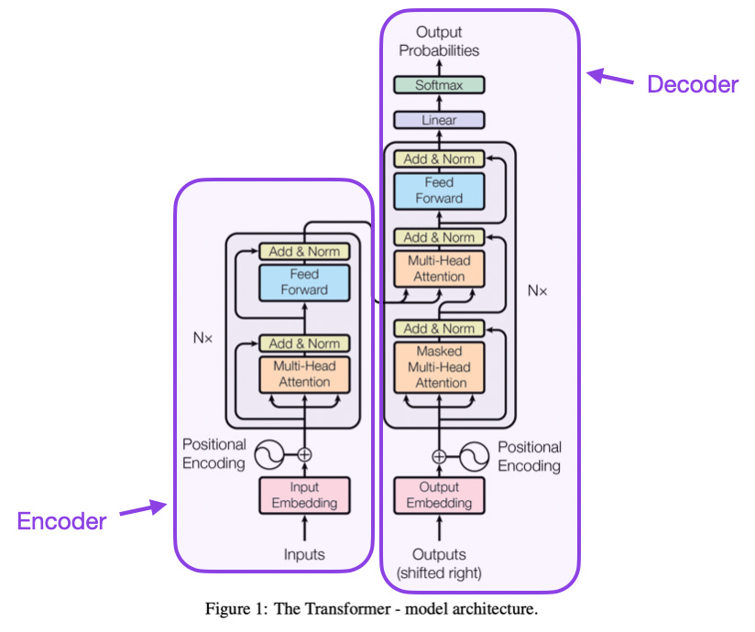
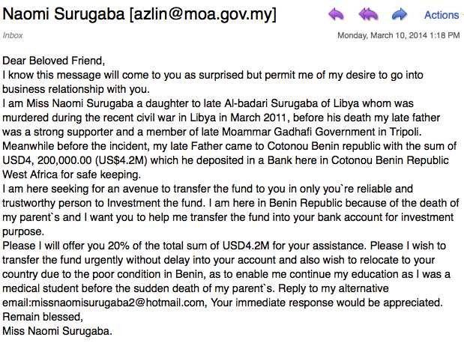
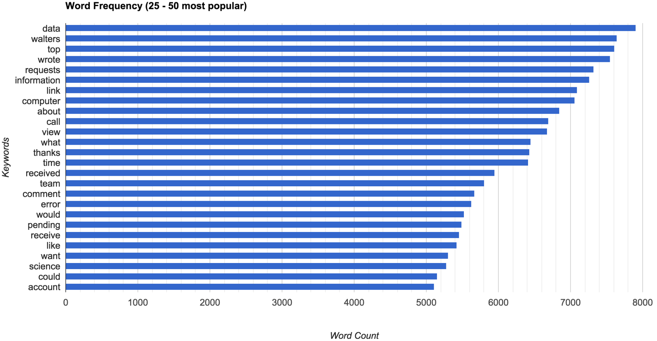
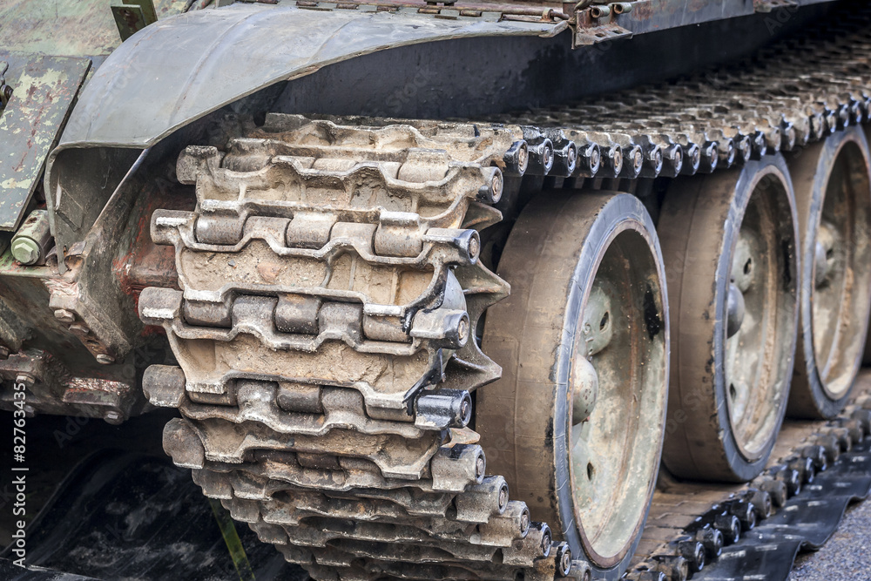
Text/ strings
Much data is in the form of text which is a complex problem
Problems with language “Time to make tracks”
Classification with language can be done in a number of ways

Slide 8
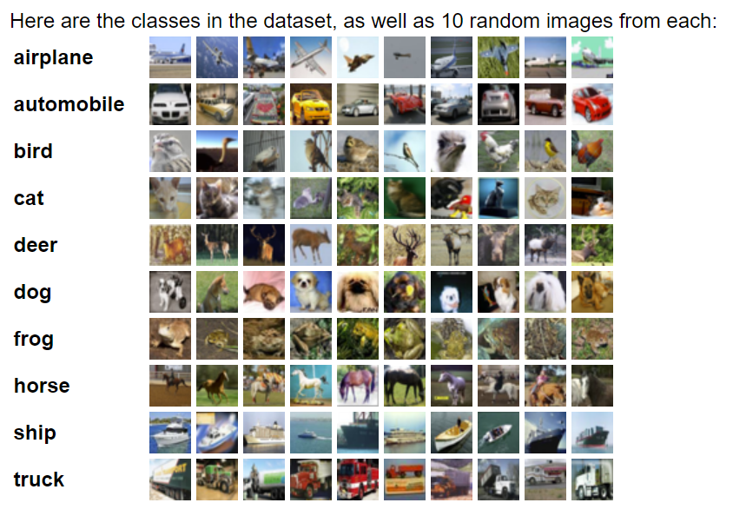
Data sets
A data set is a collection of related data
In ML, models typically require the same number of inputs each time.
Image = (200,200) = 40,000 pixels
Model inputs: 40,000
Model outputs: 10 classes
Notes:
Cifar 10

Slide 9
Onto Electronics…

Slide 10
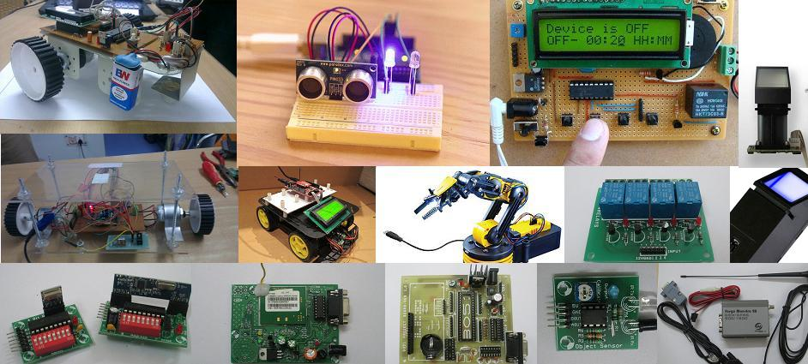
Microcontrollers
A microcontroller can be considered a self-contained system with a processor, memory and peripherals and can be used as an embedded system

Slide 11


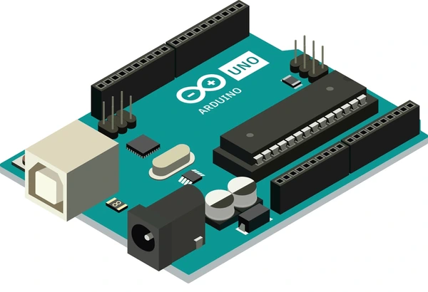
Key aspects
Energy efficient
Runs code on boot
Cheap
Can run alone or be a medium between a PC and hardware
Not as powerful as big computers
Smaller memory

Slide 12
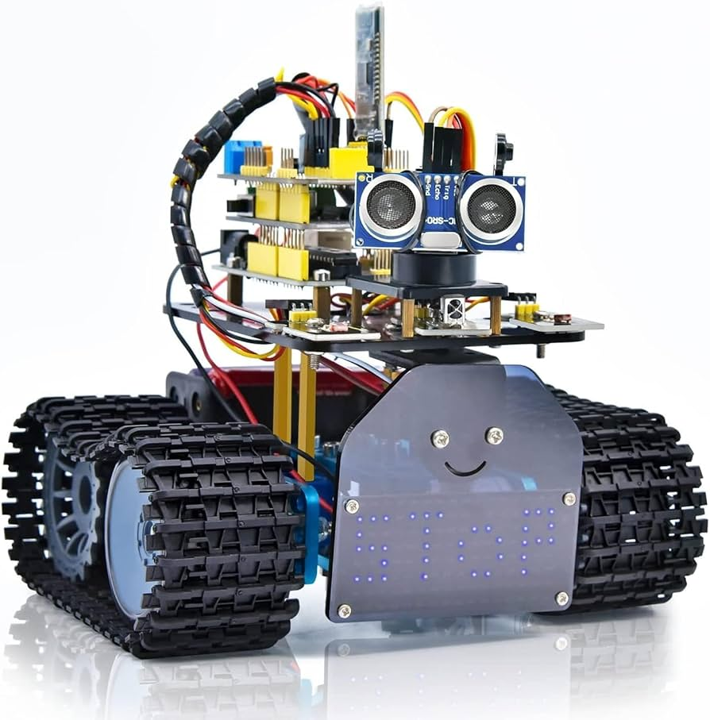
Example: Robot
Simple robot device with distance sensor
Outputs: moves motors, small LED screen
Inputs: gets distance in front of robot
Does not need a larger PC as its fairly simple

Slide 13
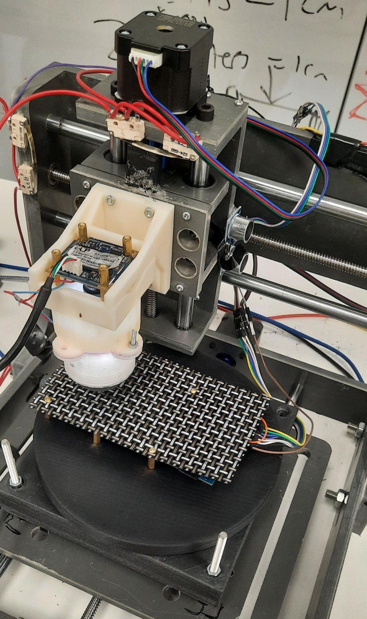
Example: Powering a rig
Collects data automatically from a sensor
Can be left running overnight, easy medium between stepper motors and PC

Slide 14
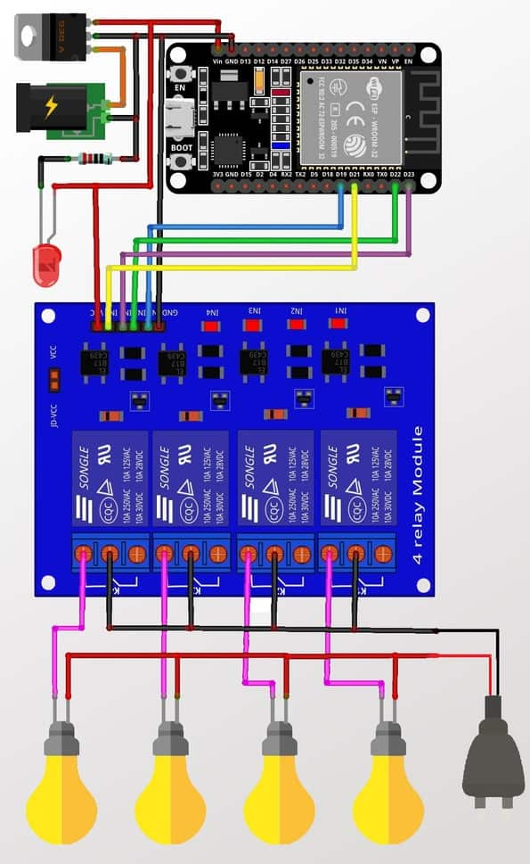
Example: Internet of Things
Devices can connect to the internet, meaning you can control hardware from your phone!
In this example there is a relay that powers light bulbs, which receives activation from a microcontroller

Slide 15
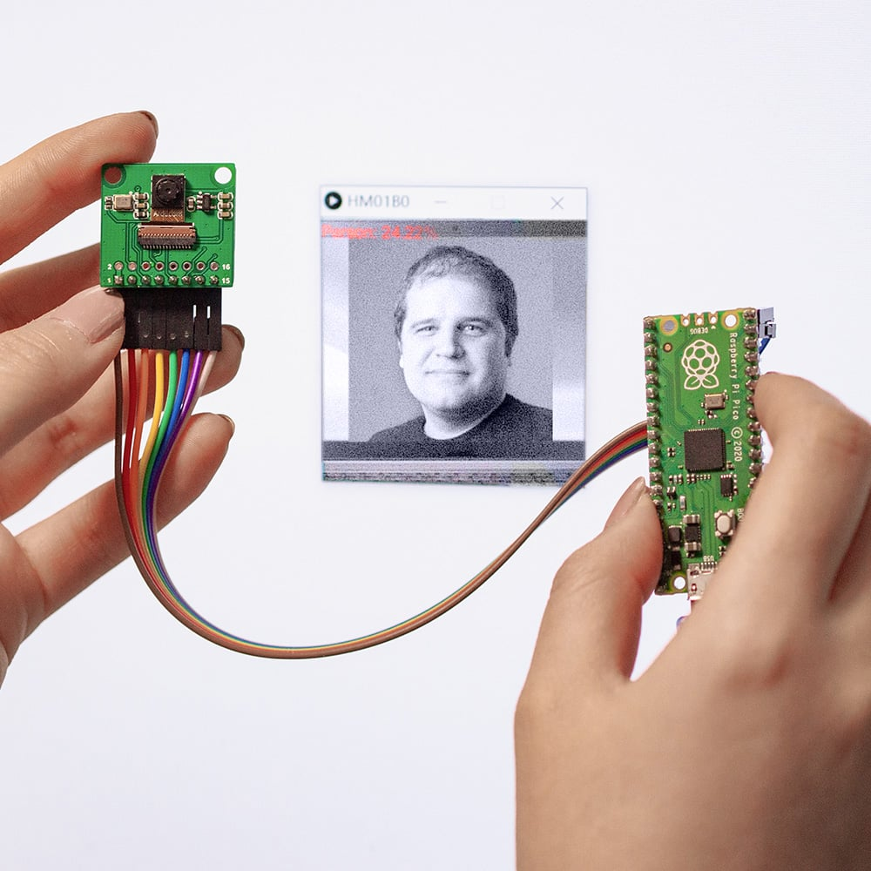

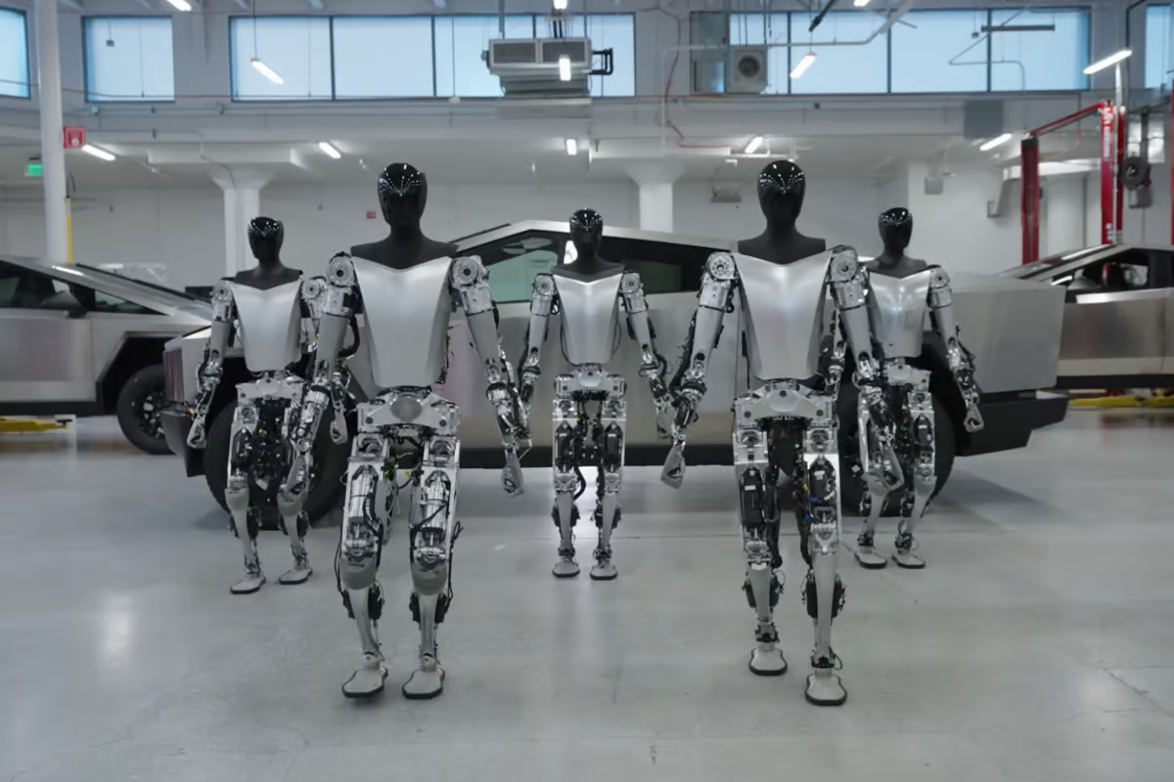
BUT it does not do everything
You can take photos on microcontrollers, but running large neural networks does not work

Slide 16
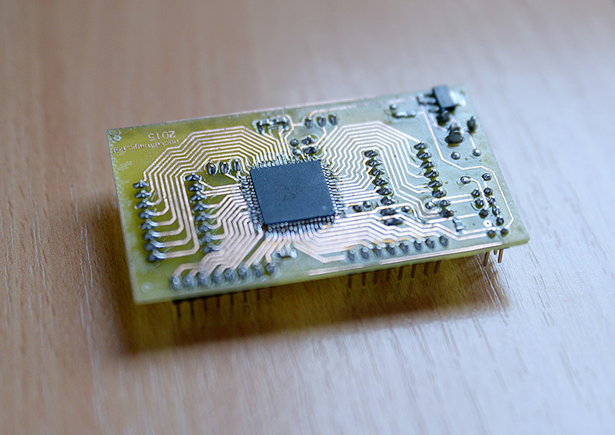
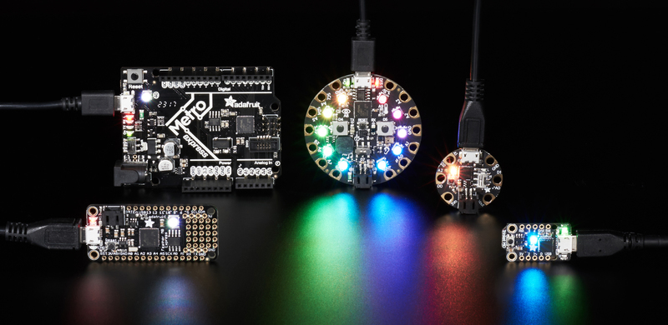
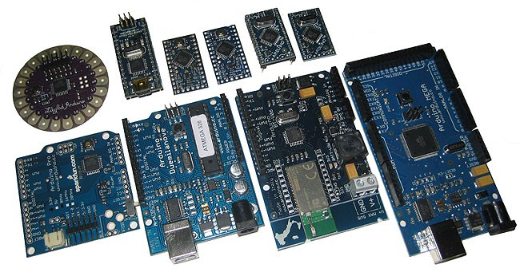
Microcontrollers

Slide 17
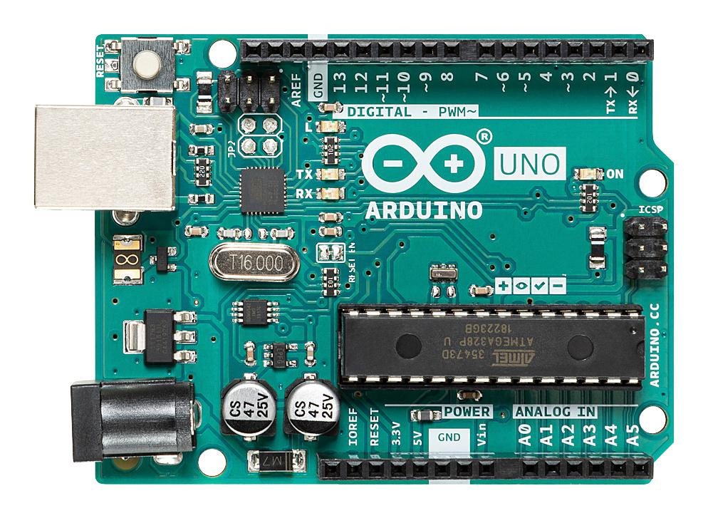
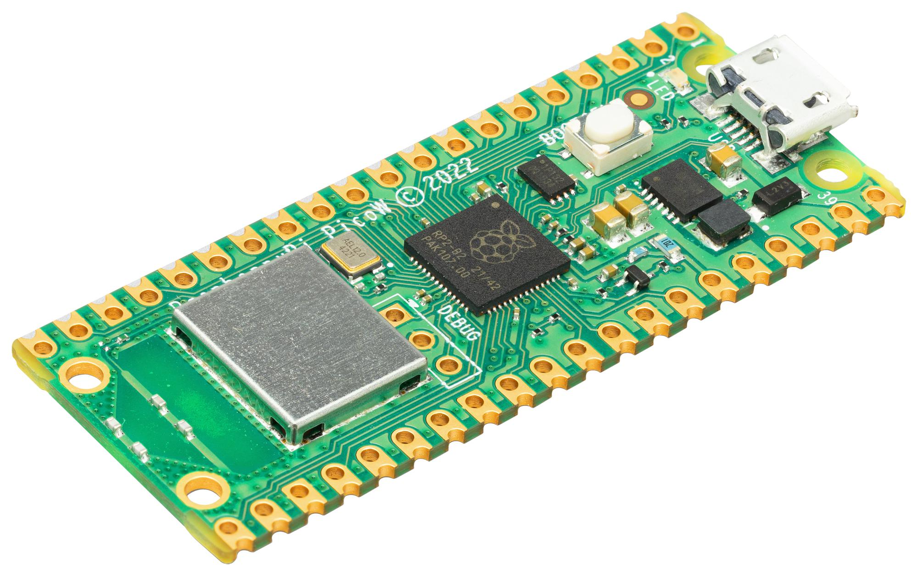
Microcontrollers
Python
Slower and less memory
Easier to understand
Arduino
Faster and more compressed

Slide 18
Python on circuit boards

Slide 19
There are many different boards
Many different boards, many different platforms
The two you will come across is micropython and circuitpython
Both are similar, but have different libraries/ support

Slide 20
Variants
Micropython
Useful library mpremote allows direct control via a PC
Circuitpython
Has access to numpy
More library support across hardware

Slide 21
The kits we have
Pico
Breadboard
Assorted wires
Senors
Camera
LEDs

Slide 22
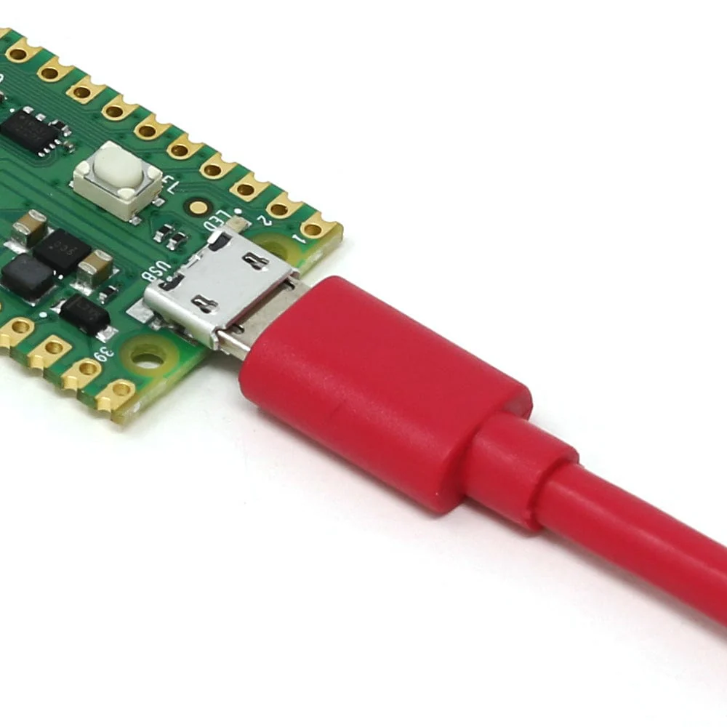
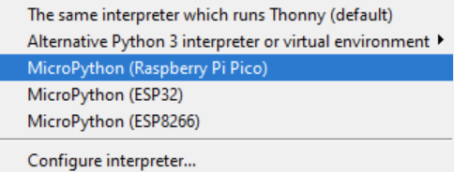
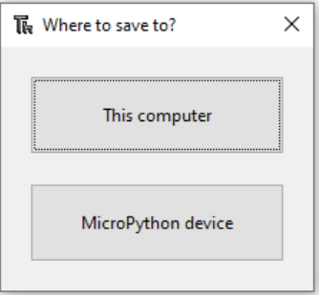
Booting
Download Thonny IDE: https://thonny.org/
Connect the robot via microUSB
Connect the device by changing the interpreter in the bottom right corner of the IDE
Once connected you can select where you wish to save code.
main.py (MicroPython) or code.py (CircuitPython) will launch on boot
For this course we will be using CircuitPython

Slide 23
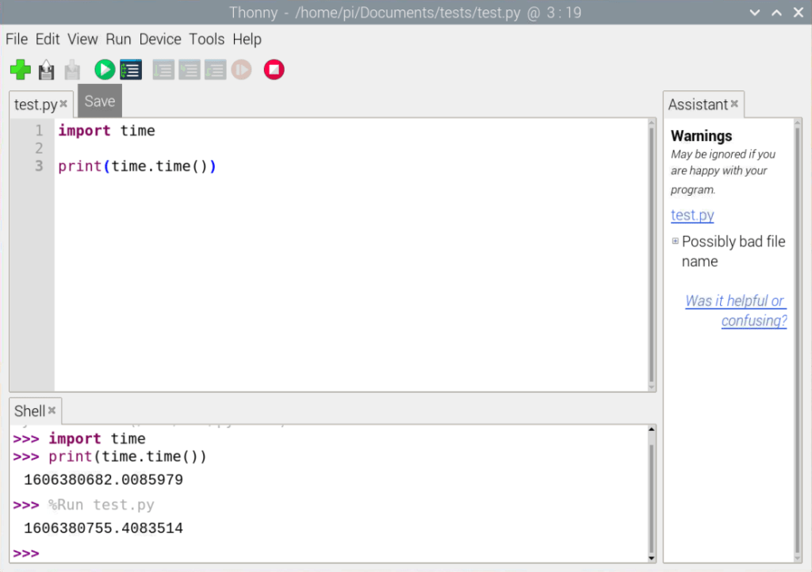
Thonny
Once connected to the device any code you run will execute on the device

Slide 24
Breadboards

Slide 25
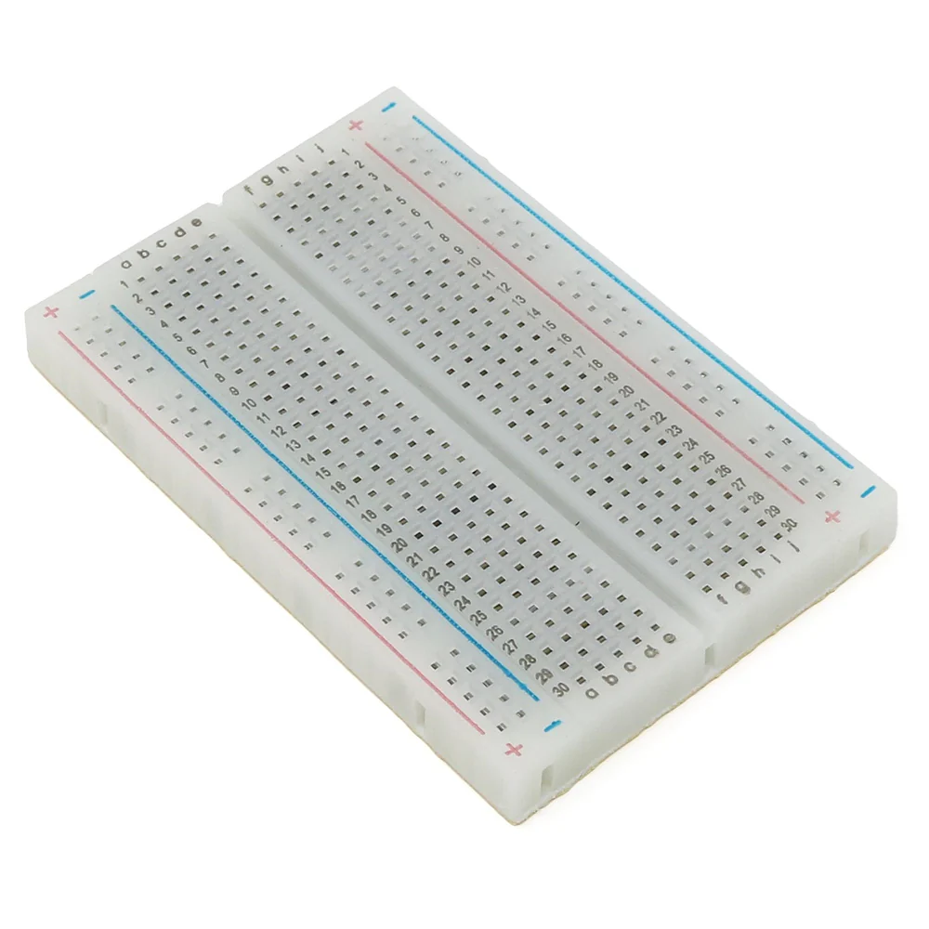
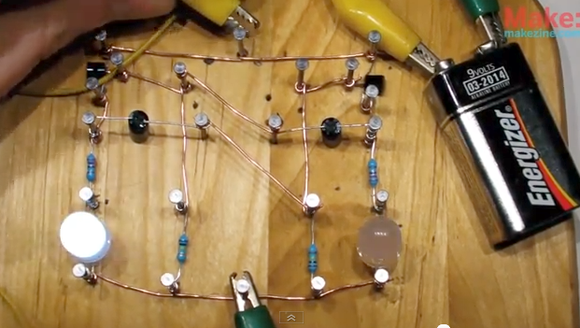
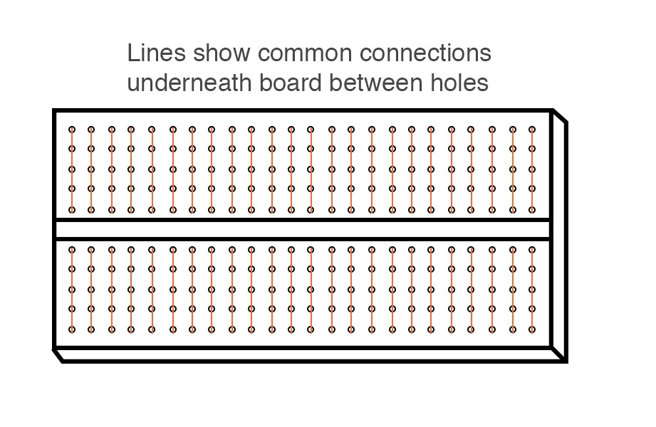
The board itself

Slide 26
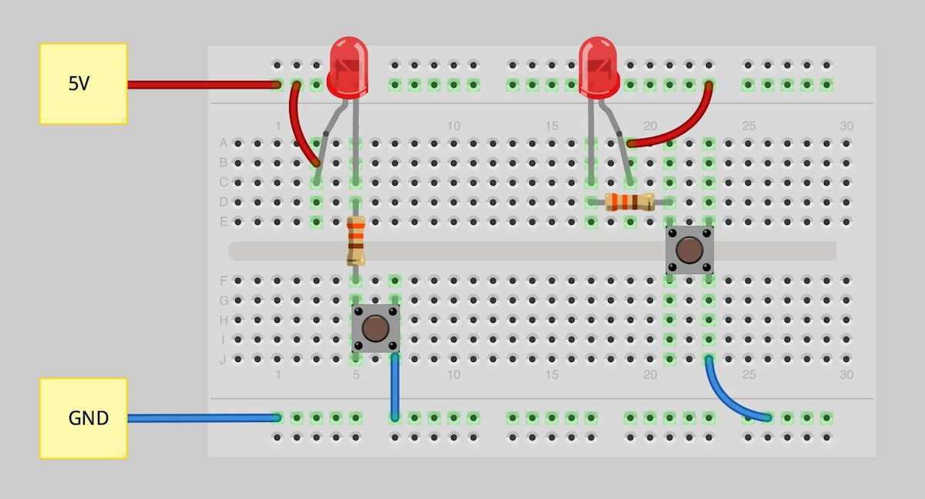
Example
Resistors limit the flow of electrical current
LEDs output light
What is connected and why?

Slide 27
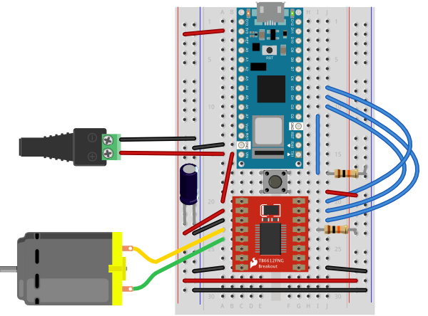
Different hardware will require different connections
LEDs are very simple, but some hardware requires more power like motors
When hardware has specific requirements, it is easiest to get a driver

Slide 28
Power
GND -
3.3v (or VCC) +
Do not connect the two directly!

Slide 29
How to know what to use
Google it!
It is even easier now with AI tools like chatGPT which will give you specifics, but Google will have an answer, datasheets telling you power requirements etc..

Slide 30
Programming

Slide 31
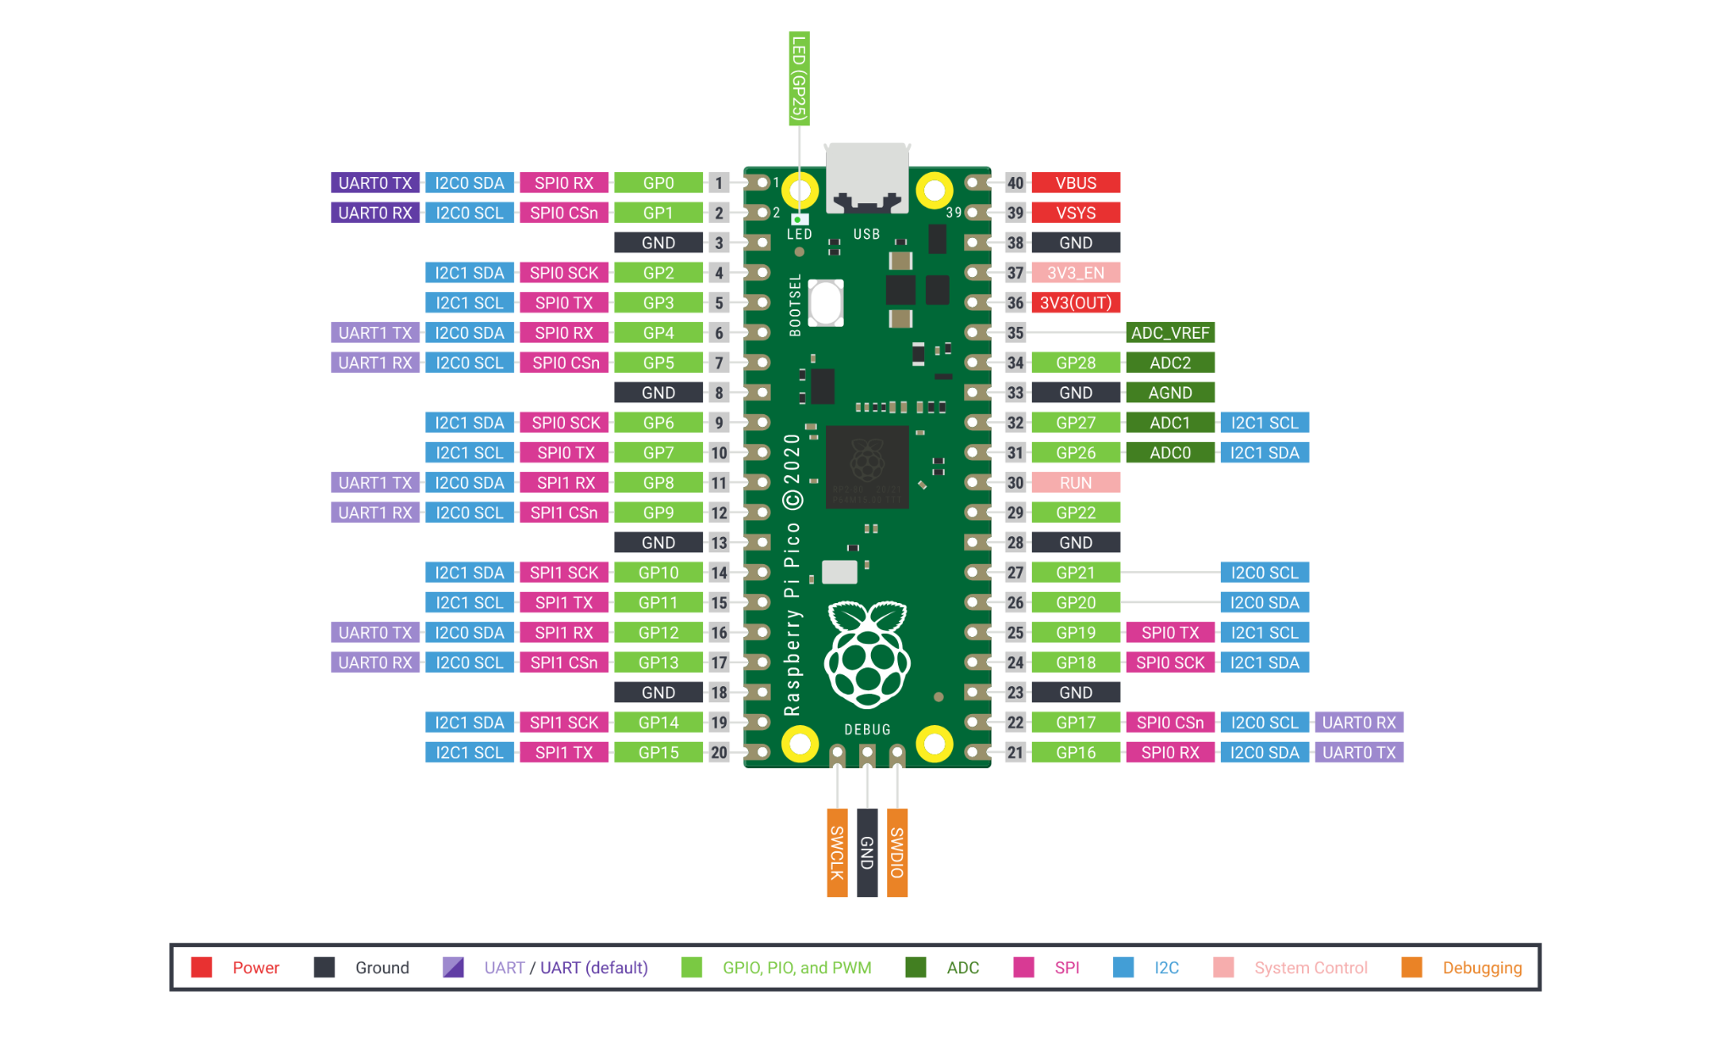
Pico pinout

Slide 32
Python is essentially the same on the devices
Some changes will occur such as different libraries, some libraries not supported, or very lite versions of the libraries.
Normal python: import numpy as np
Circuitpython: import ulab.numpy as np
https://docs.circuitpython.org/en/latest/README.html

Slide 33
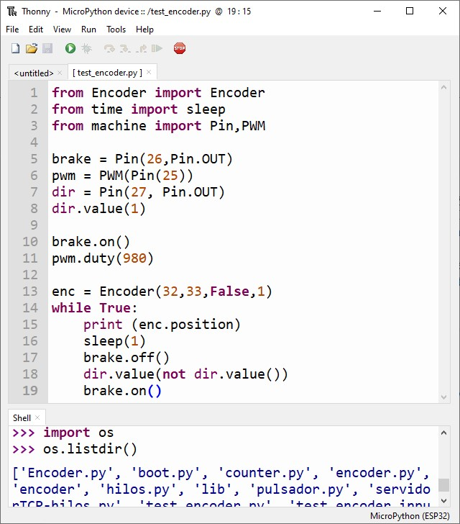
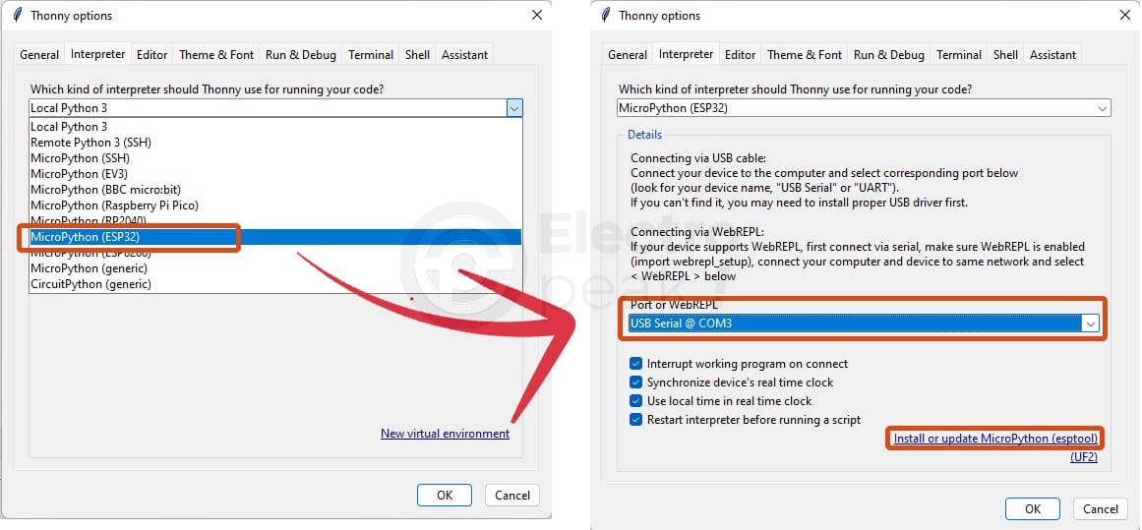
Installing
Download a software called thonny IDE
This will allow you to connect to the device

Slide 34
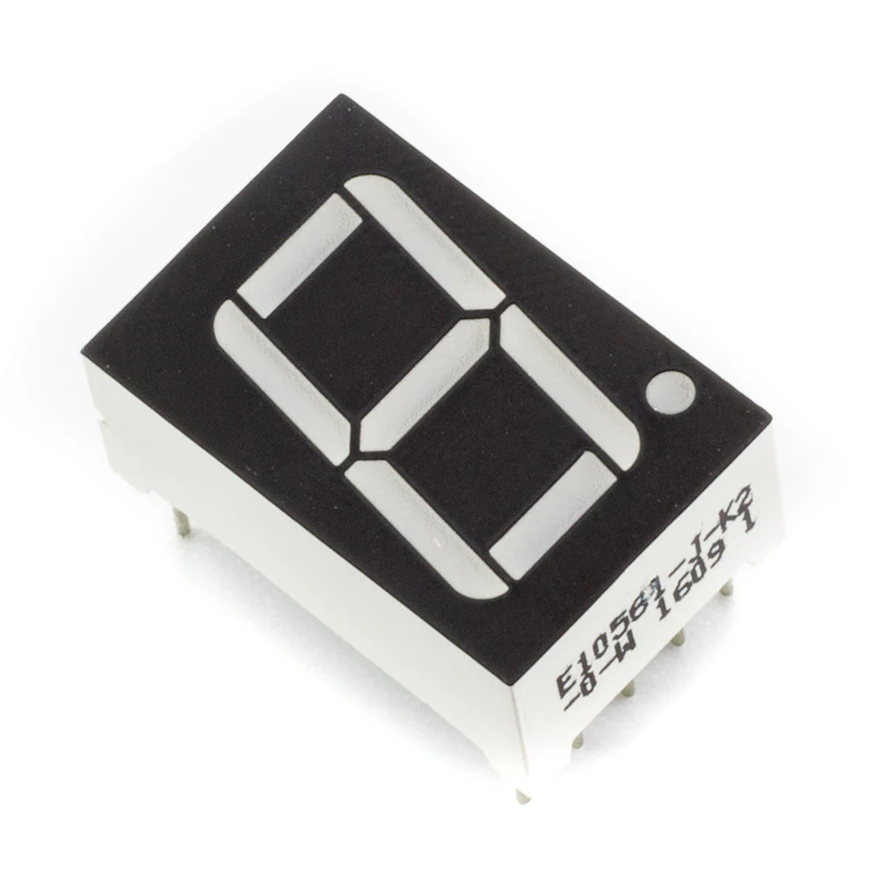
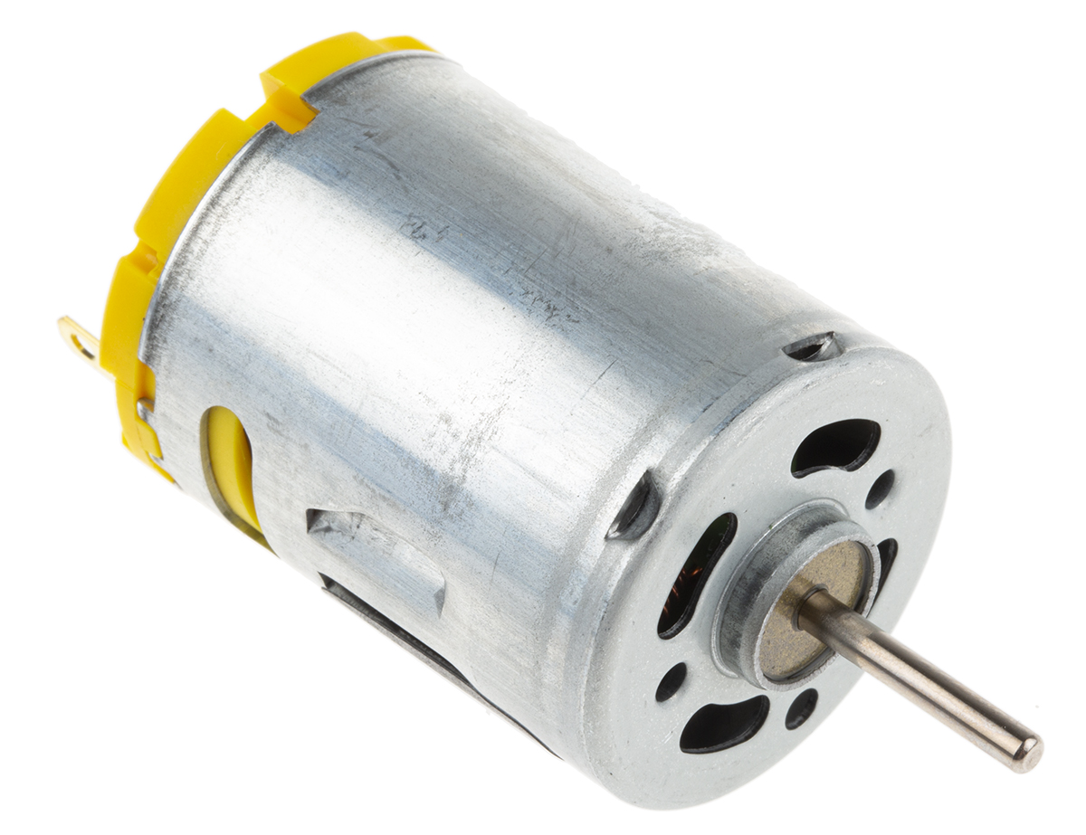
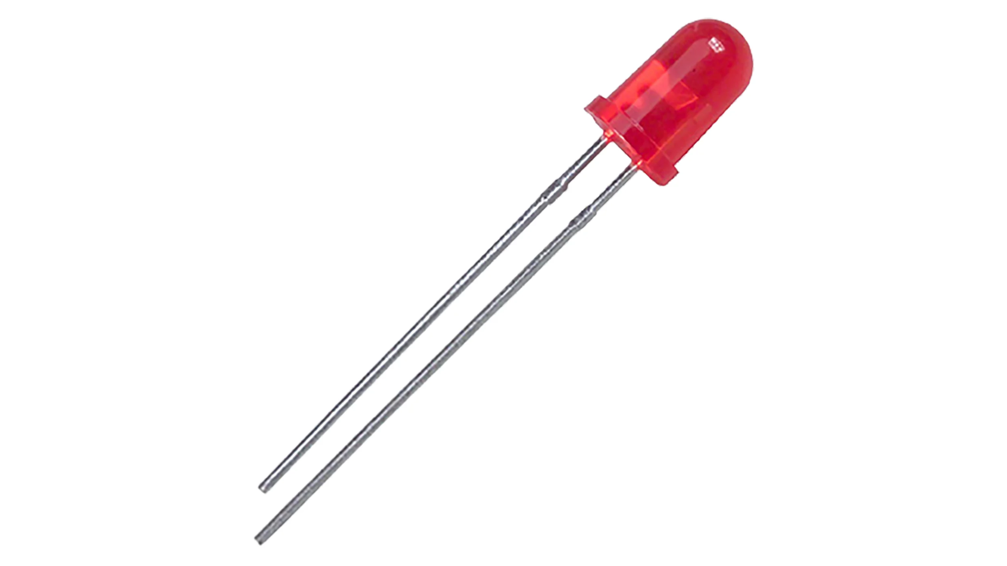
Digital output

Slide 35
Digital output
import time
import board
from digitalio import DigitalInOut, Direction, Pull

Slide 36
Digital output
# LED setup.
led = DigitalInOut(board.GP1)
led.direction = Direction.OUTPUT

Slide 37
Digital output
led.value = False
time.sleep(1)
led.value = True
time.sleep(1)
led.value = False

Slide 38
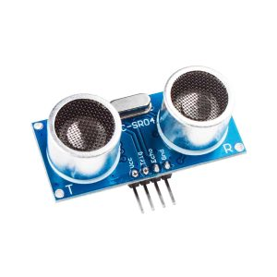
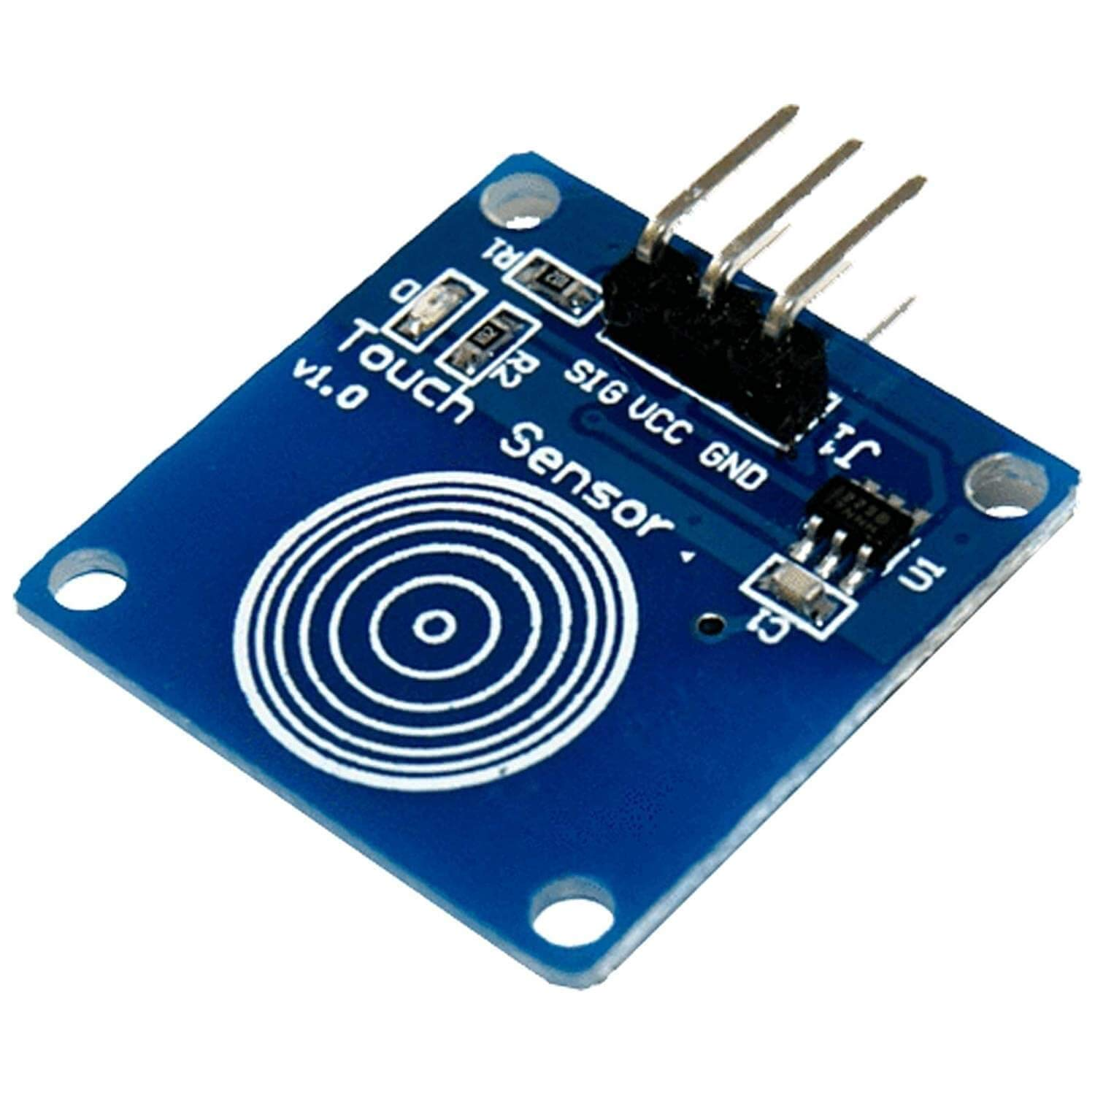
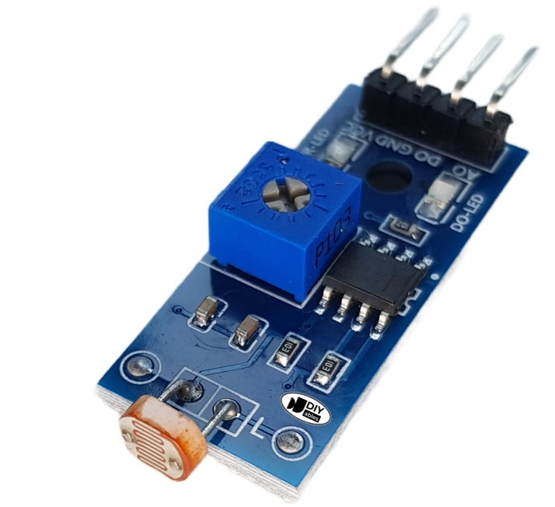
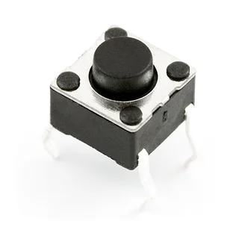
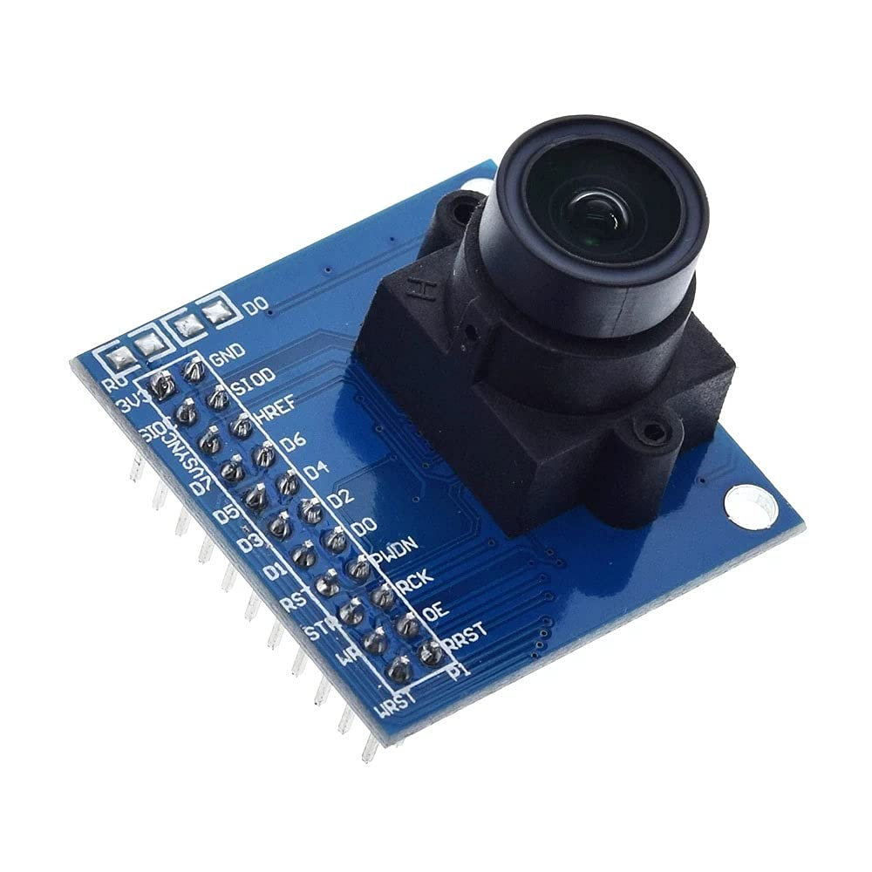
Digital input

Slide 39
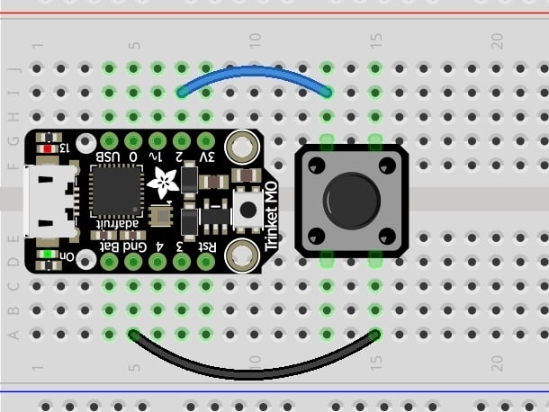
Digital input
switch = DigitalInOut(board.D2)
switch.direction = Direction.INPUT
switch.pull = Pull.UP

Slide 40
Digital input
print(switch.value) # will print a 1 or 0 depending on the voltage

Slide 41
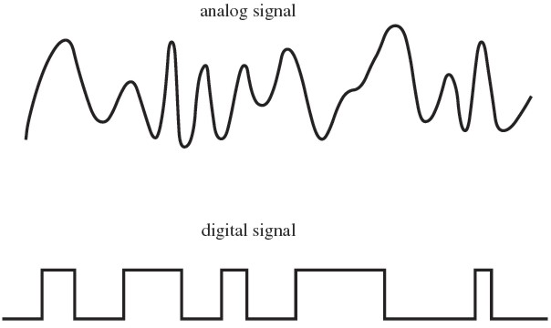
Analogue

Slide 42
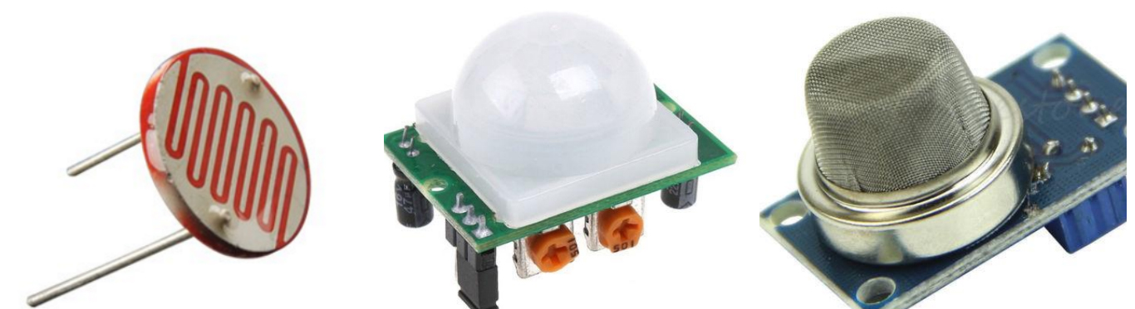
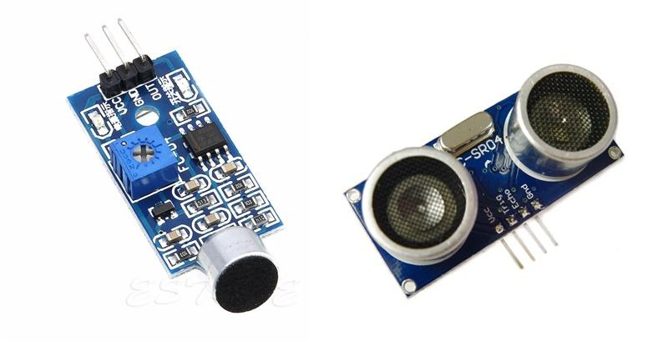
Analogue

Slide 43
Reading analogue
import time
import board
from analogio import AnalogIn

Slide 44
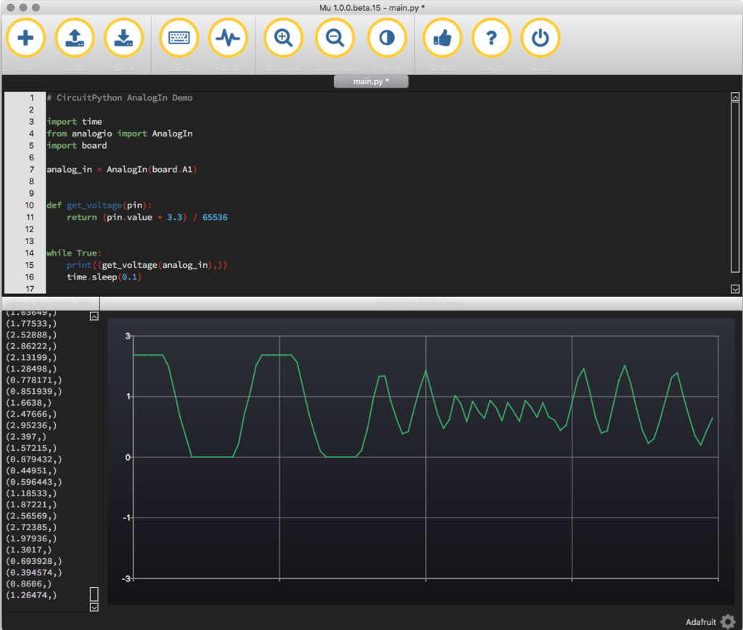
Reading Analogue
analog_in = AnalogIn(board.A1)
def get_voltage(pin):
return (pin.value * 3.3) / 65536
while True:
print((get_voltage(analog_in),))
time.sleep(0.1)

Slide 45
Setting up environment

Slide 46
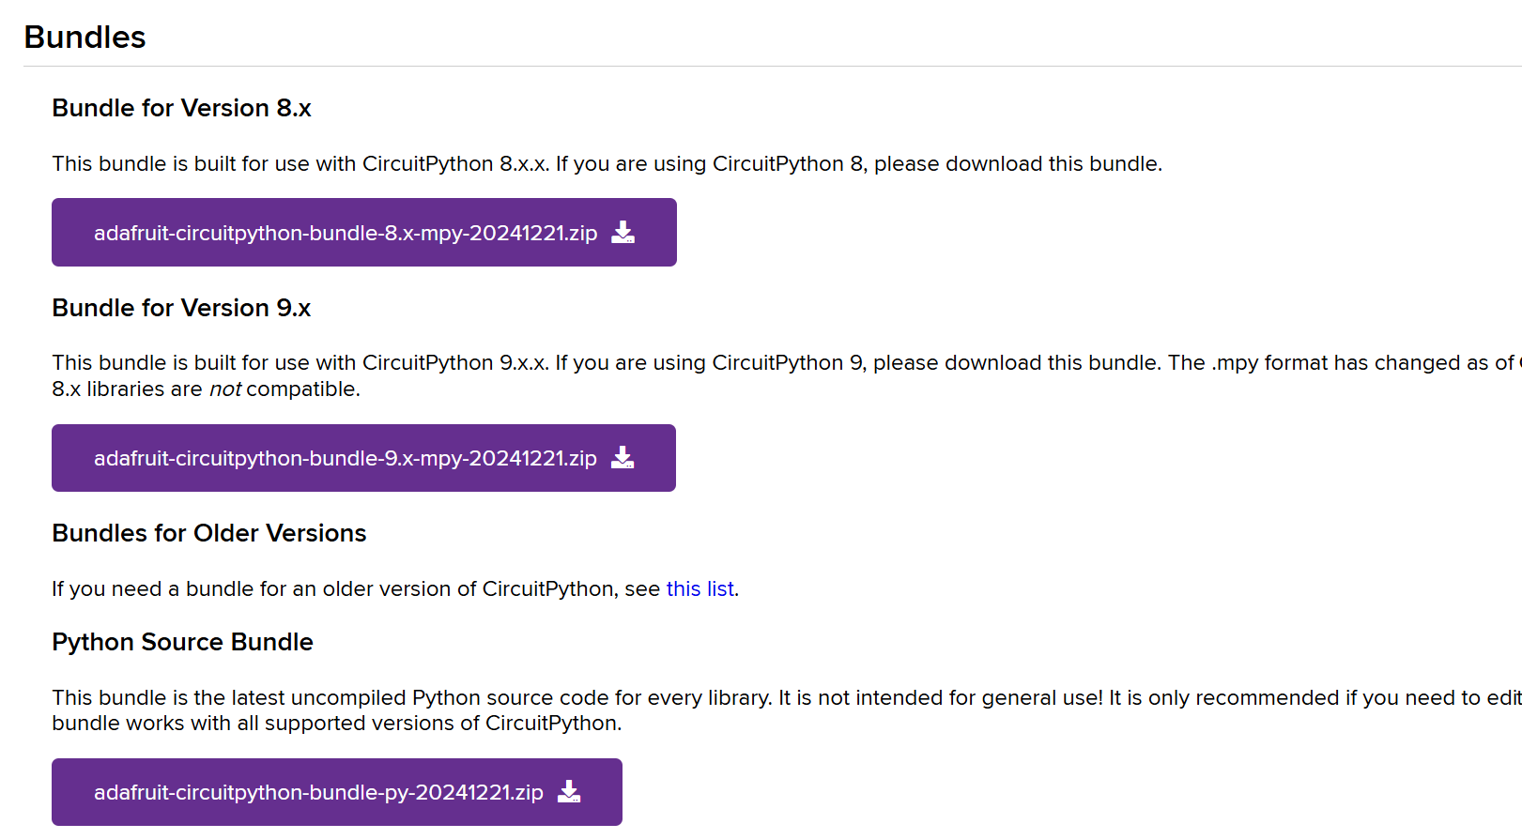
Libraries
https://circuitpython.org/libraries

Slide 47
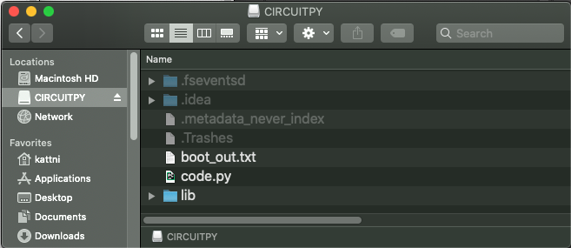
Uploading

Slide 48
Once on device
Only upload what you need otherwise it's a waste of memory
Once there you can import the libraries the same way you would with normal python

Slide 49
Connecting to sensors

Slide 50
Is it analogue or digital?
Most are clear as they have a d pin or a pin labelled on the pcb
Some you may need to read the online documentation
Sometimes you can use both, or it requires both

Slide 51
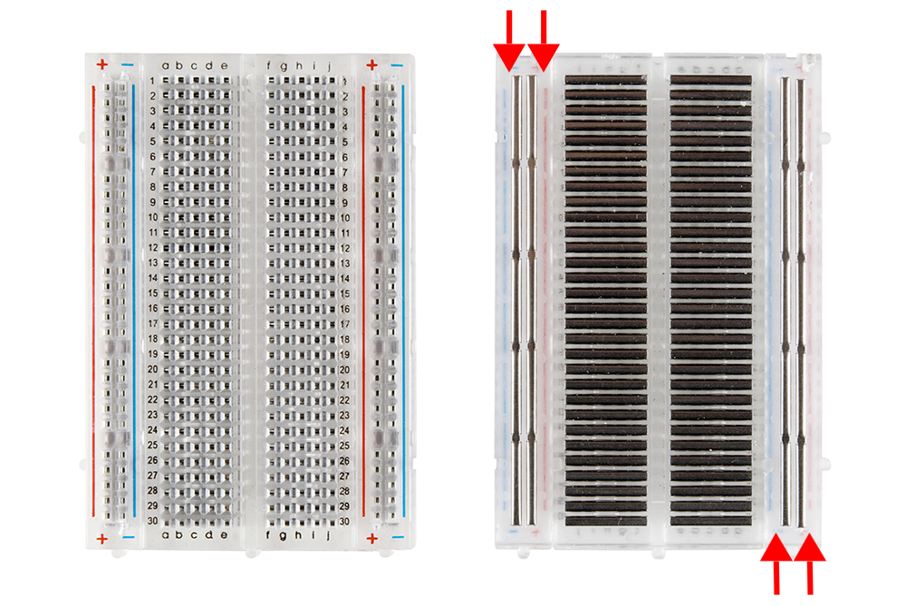
Breadboards

Slide 52



LEDs
Digital output - light
Often we use resistors to limit the power going in

Slide 53
Pull up/ pull down
Microcontroller GPIOs are high-impedance when set as inputs, meaning they can "float" between high (1) and low (0) if not connected to anything. This can cause random, unreliable readings.
To ensure a stable value, we use:
Pull-Up Resistor (Pulls pin HIGH by default)
Pull-Down Resistor (Pulls pin LOW by default)
Typically pull up for GND connection and down for 3.3/5v connection

Slide 54


Resistors
Resist the current
For low voltages this is not an issue

Slide 55


Buttons
Digital input

Slide 56


Microphones
Analogread

Slide 57


Light sensor
Analogue and digital!
Can have thresholds to determine whether it is light or not
Can have analogue to determine how light it is

Slide 58


CO2
Another analogread sensor
A bit tricky to test

Slide 59

Moisture

Slide 60


Humidity

Slide 61


MPU (accelerometer/gyro/temp)
Make sure sda and scl are same bus and correct

Slide 62
Camera connection

Slide 63

There is a lot of wiring!

Slide 64

Libraries

Slide 65

Camera library
https://github.com/shepai/CircuitPython_CV/

Slide 66
Connections
Digital pins may change name based on board used!
Power & Ground
Connect GND of Pico, and Camera
Connect 3V3 from Pico to Camera
Connect 3V3 from Pico to I2C pull-up resistors (×2)
Connect VSYS from Pico to LCD VIN
I2C Connections
Connect one I2C pull-up resistor to Pico GP8
Connect the other I2C pull-up resistor to Pico GP9
Connect Pico GP8 to Camera SDA
Connect Pico GP9 to Camera SCL
Camera Control Connections
Connect Pico GP7 to Camera VSYNC
Connect Pico GP10 to Camera RESET
Connect Pico GP11 to Camera CLOCK
Connect Pico GP20 to Camera MCLK
Connect Pico GP21 to Camera HREF
Camera Data Connections
Connect Pico GP12 to Camera D0
Connect Pico GP13 to Camera D1
Connect Pico GP14 to Camera D2
Connect Pico GP15 to Camera D3
Connect Pico GP16 to Camera D4
Connect Pico GP17 to Camera D5
Connect Pico GP18 to Camera D6
Connect Pico GP19 to Camera D7

Slide 67

Connections

Slide 68

Take a snapshot

Slide 69


What is the image format
Camera outputs a byte array in YUV format
We convert this to RGB in the snap function
Circuitpython cannot handle 3D arrays there for the shape of the array needs to be converted to (h,w,3) to view it

Slide 70
Camera uses
Making datasets with these cameras are better used as automation tasks.
A sensor could trigger the camera to take a photo
Timers could take snapshots of something in particular
If it is gathering an image dataset… then phones work just as well

Slide 71
Conclusions

Slide 72
Summary
The basics of circuitpython and programming
We looked at connecting sensors to these devices
Covered more advanced sensors such as cameras

Slide 73
The labs

Slide 74
Tasks
Get an LED blinking on and off with intervals of 1 second
Place in a button so the LED only lights up when the button is pressed
Now have it so the button toggles on and off the light instead of holding it down

Slide 75
Make a game
The game should have three buttons and 3 LEDs, plus a green and red LED.
The game will flash the LEDs in a different random order, then wait for the user to press the buttons in that order. As soon as a mistake is made the red LED blinks and the game restarts. If the user enters the correct sequence the green LED blinks and another random sequence will play.
EXTENSION: have the sequences get longer and longer as the game goes on
Further EXTENSION: Use other sensors for your game rather than just buttons

Slide 76
Further extension
Get the camera taking snapshots
Play with reading the sensors

Slide 77

Hints
Notes:
import random
import time
#TODO import other hardware libraries
sequence_options=[0,1,2]
#setup of buttons and LEDs go here
#TODO
#
#
#
while True:
sequence=[random.choice(sequence_options) for i in range(3)]#pick the random sequence
for i in range(3): #output to each LED
#TODO output to LED i
time.sleep(1)
#TODO turn LED i off
selected=[]
end=True
pointer=0
while end: #loop round waiting for inputs
pressed1=#TODO read button one
pressed2=#TODO read button two
pressed3=#TODO read button three
options=[pressed1,pressed2,pressed3]
if 1 in options: #means that one of the buttons is pressed
button=options.index(1) #get which button is pressed
if button==sequence[pointer]: #correct
if len(selected)==len(sequence):#all pressed
#TODO turn on blue LED

